Slide 1

Tech Instagram Influencer Account Analysis
Part of Data Analyst Internship @ AtliQ Technologies Designed & guided by Codebasics Presented by Devika Suresh

Slide 2
About the Project
📌 Instagram Influencer Account Analysis
An analytical deep dive into an Instagram tech influencer's account, using SQL to extract insights on content performance, audience growth, and engagement patterns. Goal: Help the influencer & marketing team make data-driven decisions to increase reach and engagement.

Slide 3
Problem Statement
A leading tech Instagram influencer wants to better understand how their content performs and what drives audience engagement and follower growth.
The challenge is to analyze daily Instagram activity data — including post types, impressions, reach, likes, and follower stats — to answer key business questions, uncover actionable insights, and help the influencer make data-driven decisions to grow their presence.

Slide 4
Data Overview
This analysis uses three main tables:
fact_content — Daily Instagram post data (type, category, impressions, engagement metrics)
fact_account — Daily account-level metrics (profile visits, new followers)
dim_dates — Calendar data (date, month, weekday/weekend, week number)

Slide 5
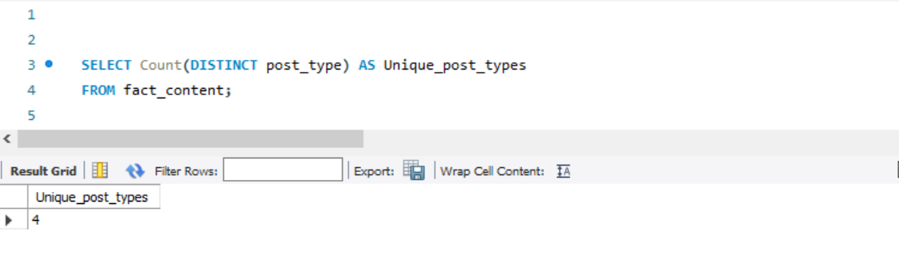
Q1: How many unique post types are found in the 'fact_content' table?
Insights:
The influencer publishes content in 4 unique post types — Images, Videos, Reels, and Carousels ensuring a diverse content mix that can engage different audience segments.

Slide 6
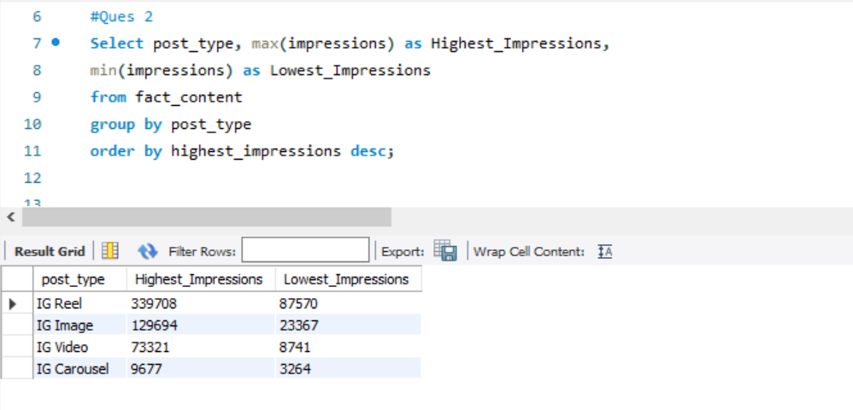
Q2: What are the highest and lowest recorded impressions for each post type?
Insights:
Some post types consistently achieve higher impressions — especially Reels, which stand out for reach. This insight can guide us to prioritize formats that maximize visibility.

Slide 7
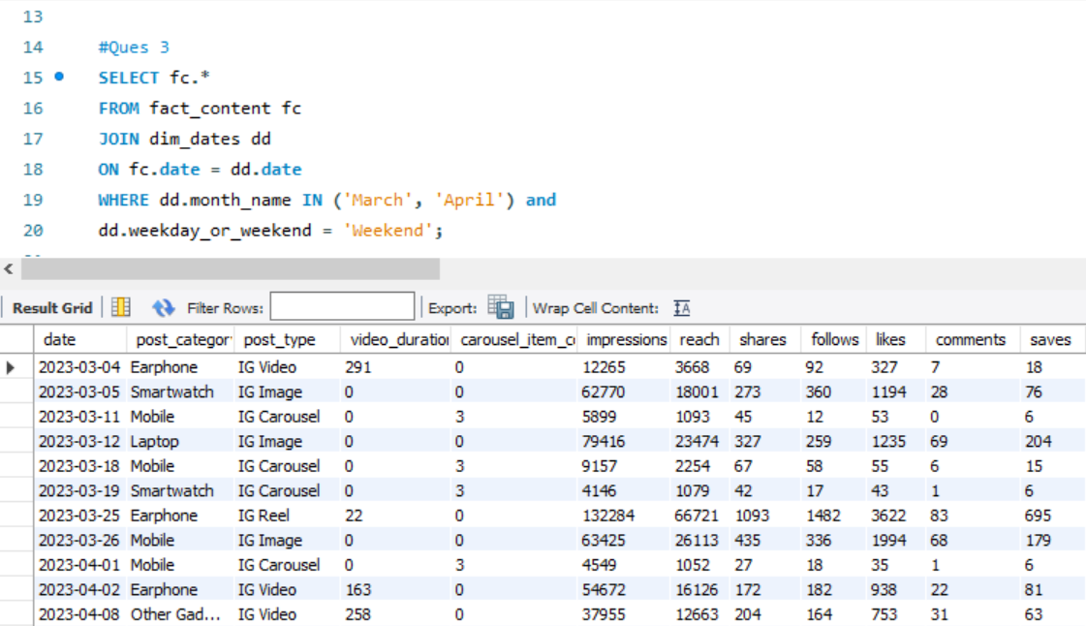
Q3: Filter all the posts that were published on a weekend in the month of March and April and export them to a separate csv file.
Insights:
Is weekend publishing effective? Filtered weekend posts from March & April to analyze engagement trends on non-working days.

Slide 8
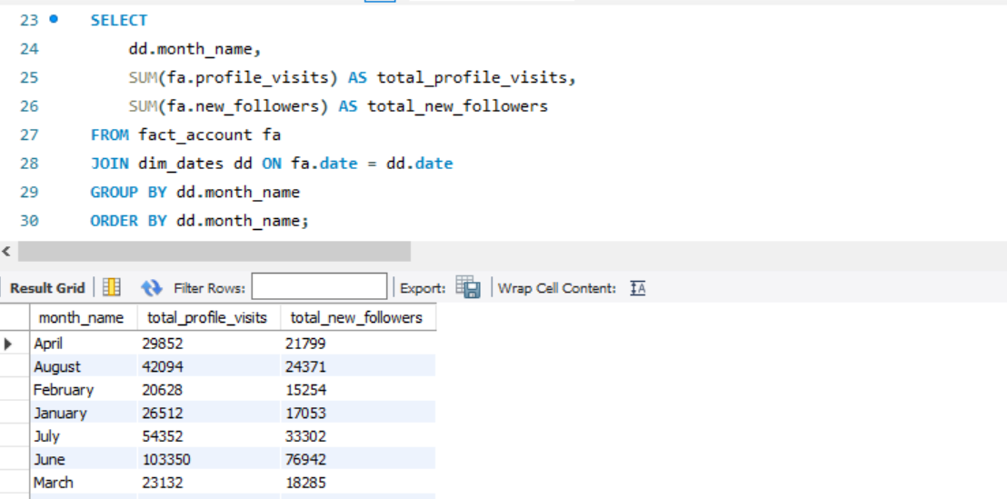
Q4: Create a report to get the statistics for the account (month name, total profile visits, total new followers).
Insights :
Created a monthly report to track total profile visits and new followers — helping identify trends and peak growth periods.

Slide 9
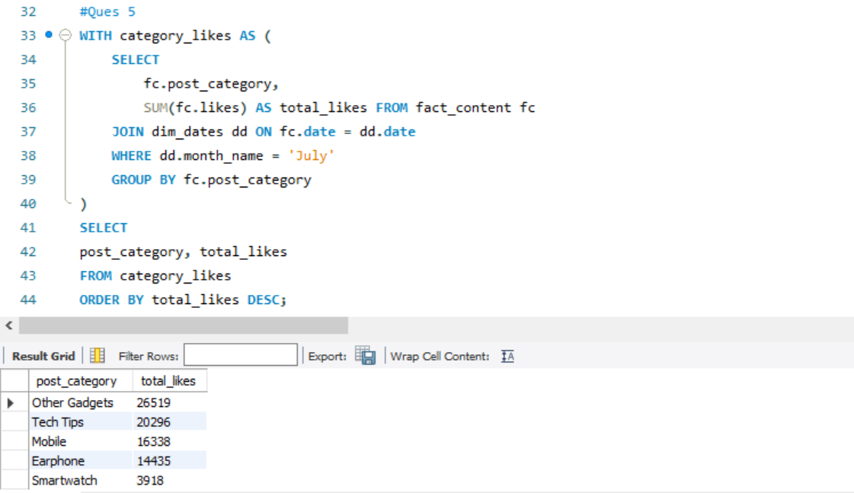
Q5: Calculate the total number of likes for each post category during July and arrange them in descending order.
Insights :
Analyzing likes by category during July highlights which product themes resonate most with the audience — guiding content focus for upcoming campaigns.

Slide 10
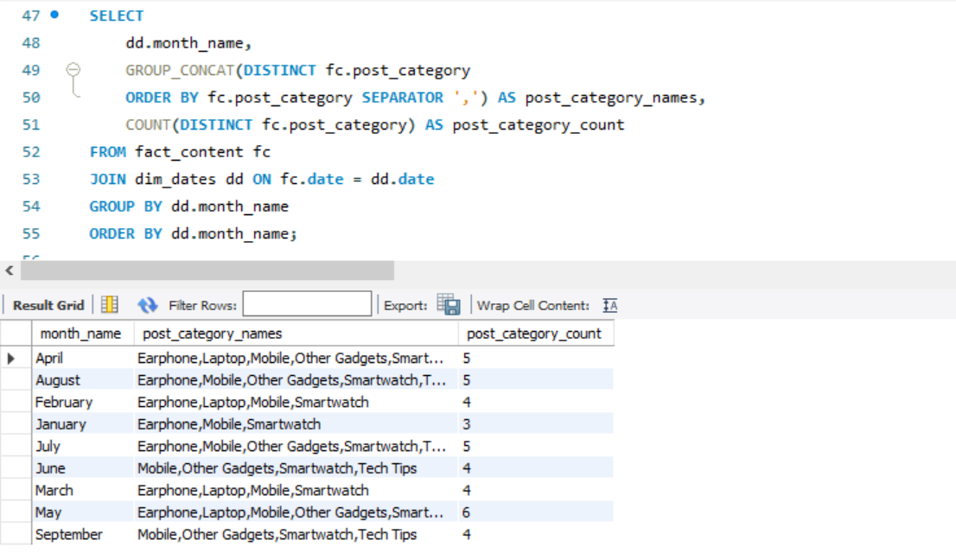
Q6: Create a report showing the unique post category names and their counts for each month.
Insights : Built a report showing unique product categories and their counts each month — helping track content diversity over time.

Slide 11
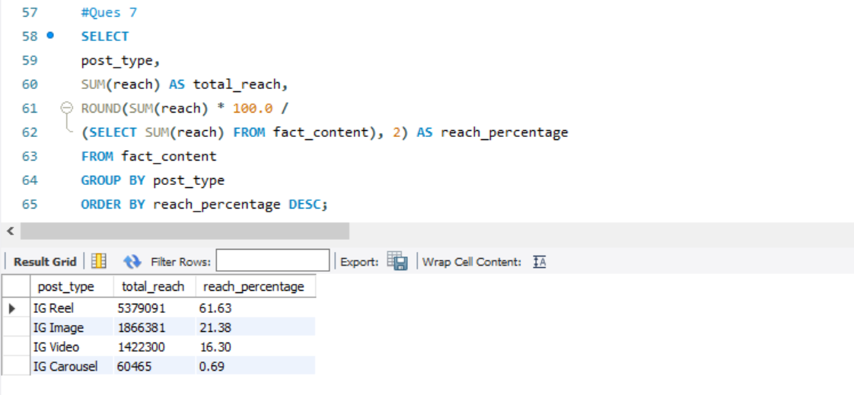
Q7: What is the percentage breakdown of total reach by post type?
Insights :
Calculating total reach by post type shows which formats drive most of the audience exposure helping refine content strategy for broader visibility.

Slide 12
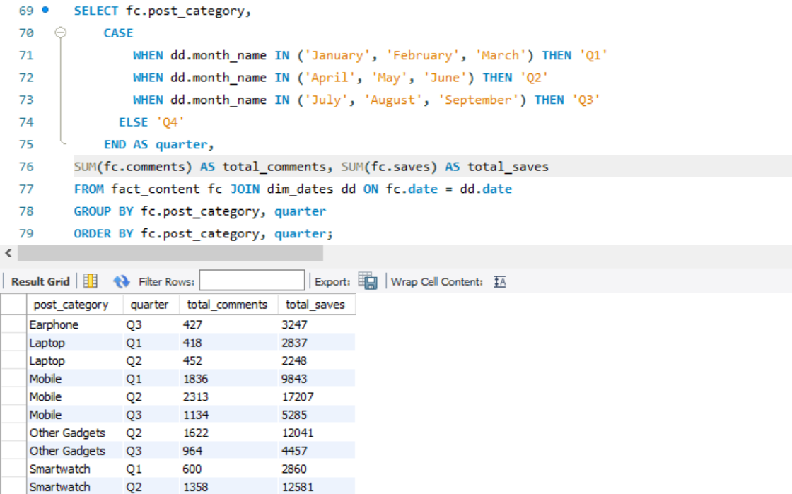
Q8: Create a report that includes the quarter, total comments, and total saves recorded for each post category..
Insights :
Created a quarterly report of total comments and saves per product category — revealing which content drives engagement each quarter.

Slide 13
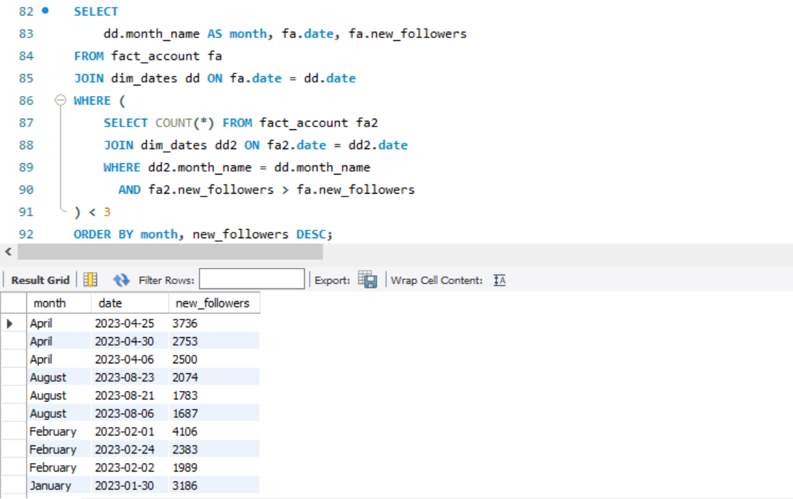
Q9: List the top three dates in each month with the highest number of new followers.
Insights :
Identified the top follower gain days each month to understand which posts or timing drove spikes in audience growth.

Slide 14
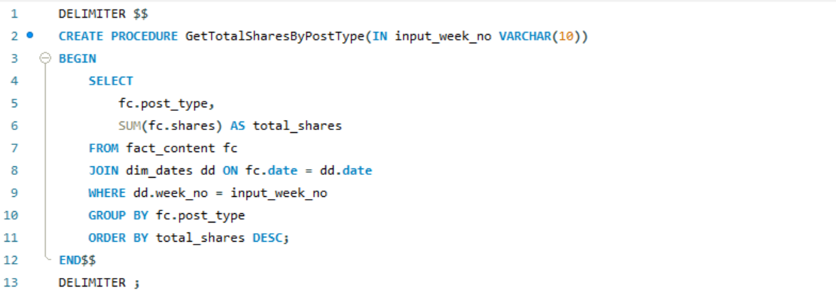
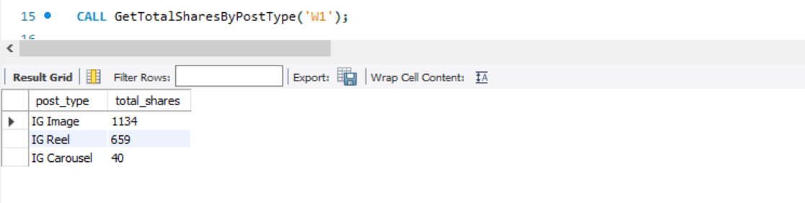
Q10: Create a stored procedure that takes the week number as input (e.g., 'W1', 'W2') and shows total shares for each post type..
Insights :
We built a stored procedure where we can input week numbers like ‘W1’, ‘W2’, etc. to instantly get total shares by post type for that week — making weekly content tracking faster and supporting agile content planning.

Slide 15
Key Insights
The influencer publishes across 4 unique post types (Images, Videos, Reels, Carousels) — keeping the feed varied.
Reels consistently generate the highest impressions — the best format to boost reach.
Profile visits & follower growth vary by month, revealing seasonal audience patterns.
Weekend posts in March & April were filtered for deeper analysis of weekend impact.
The stored procedure helps quickly track weekly shares by post type, supporting agile content planning.

Slide 16
Recommendations
✔ Focus more on Reels to maximize reach and impressions. ✔ Analyze weekend posts to optimize weekend content strategy. ✔ Use the stored procedure weekly to monitor shares and adjust campaigns in real time. ✔ Track monthly trends in followers & visits to plan content around audience peaks. ✔ Prioritize top-performing product categories to match audience interests.

Slide 17
Thank You
Happy to answer any questions.
github.com/Devika-Rani18/instagram-influencer-analysis Presented by Devika Suresh
Data Analyst Virtual Internship @ AtliQ Technologies

